Slide 1
Aspiring Minds
Rounds- 2 Q5 – Insurance (Micro-services)

Slide 2











Answer: #5
Description:
A basic Health Insurance Calculator application build using micro-services architecture. The premium and payment services are separated as micro-services and run independently.
Technology Used:
Frontend Middleware Backend Logging & Documentation
HTML5 CSS3 NodeJS ExpressJS JSONSchemaValidator MongoDB Log4JS Swagger UI
Test Case Deployment Source Code management
Mocha Jenkins Git
2017
2019

Slide 3
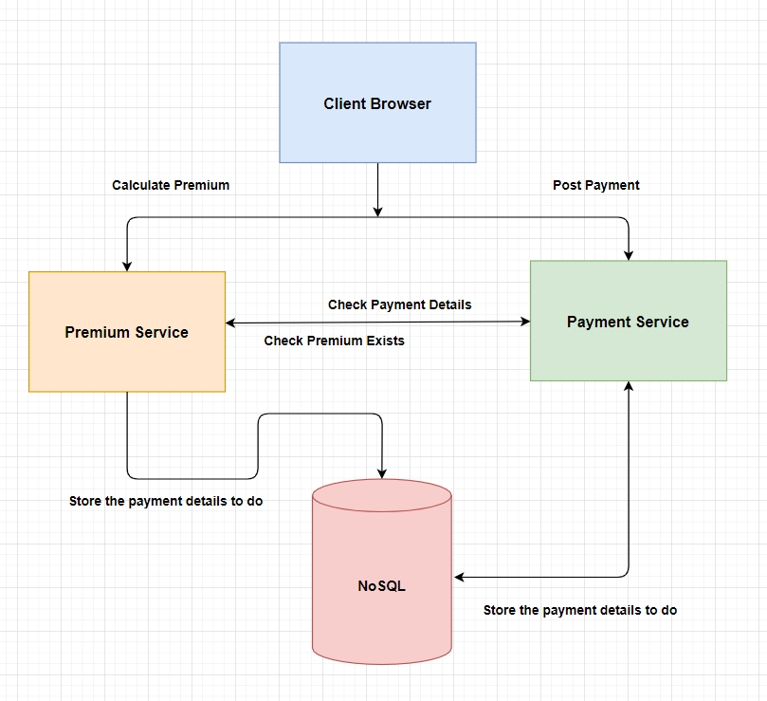
2. Functional Flow

Slide 4
3. BDD File
Please refer the attached text file from below

Slide 5
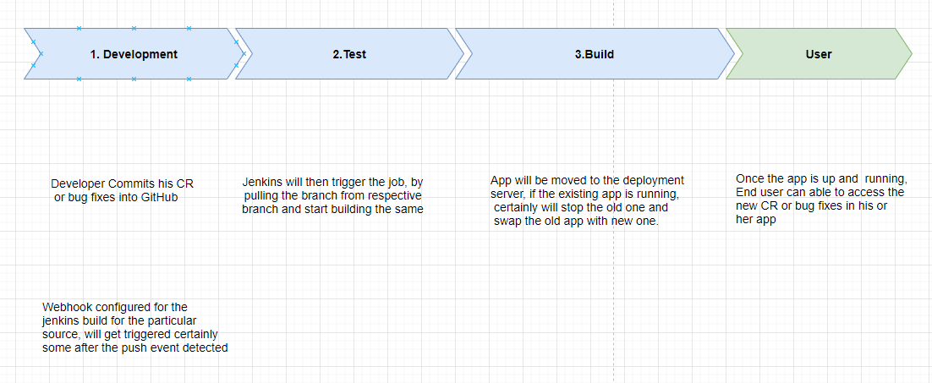




4. Auto Deployment

Slide 6
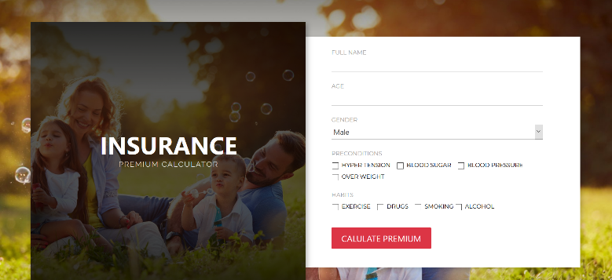
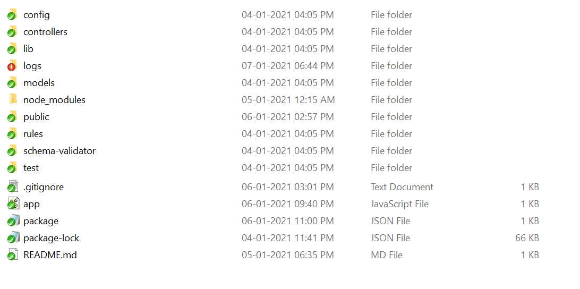
4. Application Folder Structure
Describe we have separate services for premium calculation and payment
service
Config - holds the services running port, logging & database config details
Controlles - holds the routing and endpoints details
Lib - hold logger & db object initialization
Logs - hold the application logs of each steps
Models - holds the database objects
Models - holds the database objects
Rules - holds the premium calculation defined values like criteria and percentages
Schema-validator - holds the json schema validation rules. Since, we have developed a micro-services with rest-api we have to validate the request body before taking considering for processing
Test - holds the unit test scripts for premium calculations
Validation - holds the bot auto reply message validations, questions & constants
App.js - Application initialization with web socket and port binding
Package.json - holds the dependencies

Slide 7

5.1 Screens
Insurance Premium Calculation

Slide 8
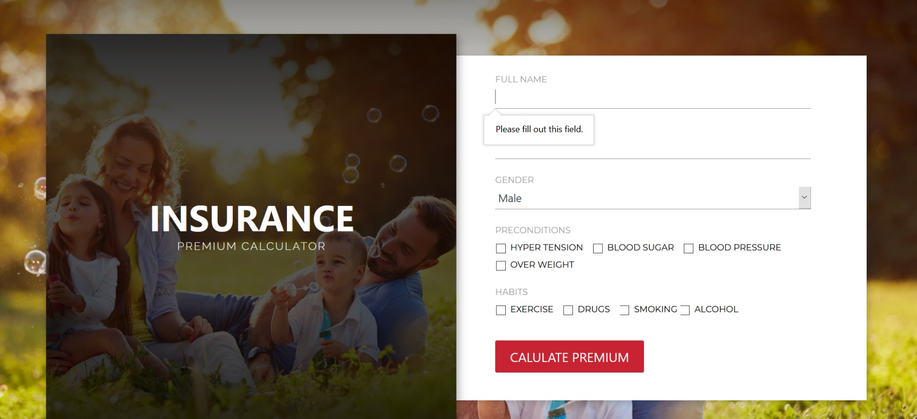
5.2 Screens
Insurance validating Screquired fields

Slide 9
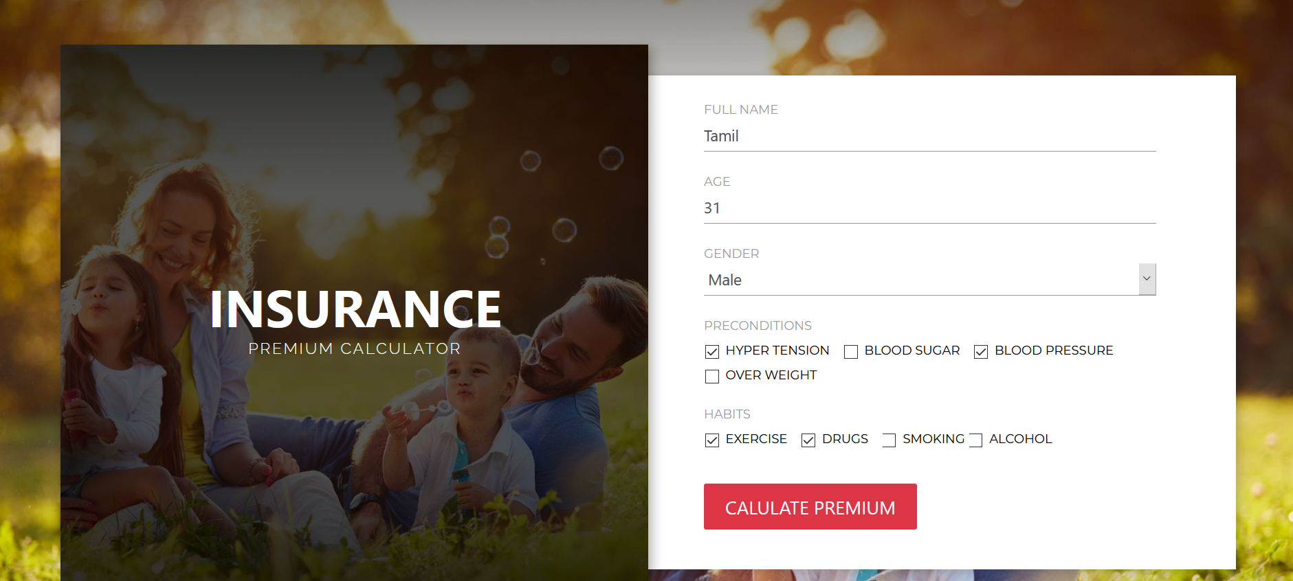
5.3 Screens
Insurance screen with Premium input

Slide 10
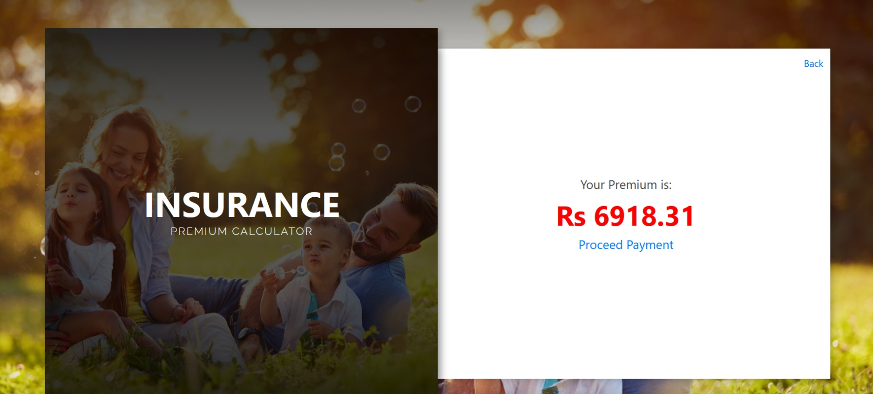
5.4 Screens
Insurance premium calculated result
On payment it will call the payment micro-service

Slide 11

5.5 Screens
Insurance premium payment success

Slide 12
6. Involvement From Team
UI & UX - Santhosh
BDD Preparation - Sathiyaraj
Core Development - TamilSelvan.P
Testing - GowthamRaj & Dhanakumar
Build Automation – SathishKanna
Mentor - Balu Periyasamy

Slide 13
Thank You

